Slide 1


Breast Cancer Detection

Slide 2

Project Team
Ali Adel Ali
Ahmed Ebrahem Abdelazem
Mohamed Gamal Mohamed
Sohaila Ashraf Abdelmonem
Ali Reda Ali
Abdelrahman Khairy Mohamed
Hussein Nabil Amer
Under Supervision of
Dr. Ahmed Hagag

Slide 3

Contents
Introduction
Project Idea
Dataset
DL Model
Survey
Existing Solutions
Future Work

Slide 4
Introduction

Slide 5
Breast cancer is a disease in which abnormal breast cells grow out of control and form tumors. If left untreated, tumors can spread throughout the body and become fatal.
Breast Cancers in women occur with no identifiable risk factors other than sex and age.
Breast Cancer occurs in every country in the world.
There are several factors contributing to the spread of Breast Cancer

Slide 6

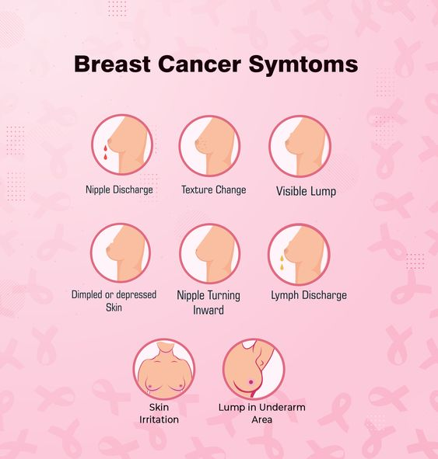
FAQs
These FAQs provide a starting point for understanding breast cancer
Symptoms
Symptoms of breast cancer can include:

Slide 7
Project Idea

Slide 8

Web application using deep learning techniques
We enter the image from the user for deep learning Model as a input , and it classifies the image if the user has Breast Cancer or not “ it's Benign or Malignant ”

Slide 9
Home Screen

Slide 10
Symptoms Screen

Slide 11
Treatment Screen

Slide 12
Check Screen

Slide 13
Chat Bot ( New Addition)

Slide 14
Dataset

Slide 15
About Dataset
Name : Ultrasound Breast Images for Breast Cancer
Published in :
Fri _Apr _10_ 2019
Publisher :Vuppala Adithya
This dataset consists of ultrasound images related to benign and malignant breast cancers.
Ultrasound Breast Classification(2 directories)
Downloads
About this directory
The Train and Val files consists of two classes, namely Benign and Malignant tumors.
1578
in the last 30 days

Slide 16
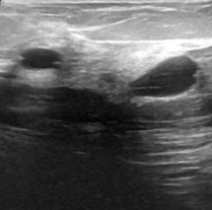
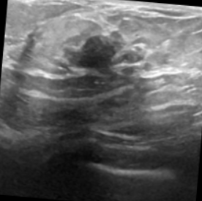
Our data-set Contains of Ultrasound Images of Breast for cancer detection that are split into train, val(Bengin,Maliganat). That all images are size of (592 MB) . 9016 files, Benign(4074 files) , Malignant(4042 files).
Bengin
Malignant

Slide 17
DL Model

Slide 18
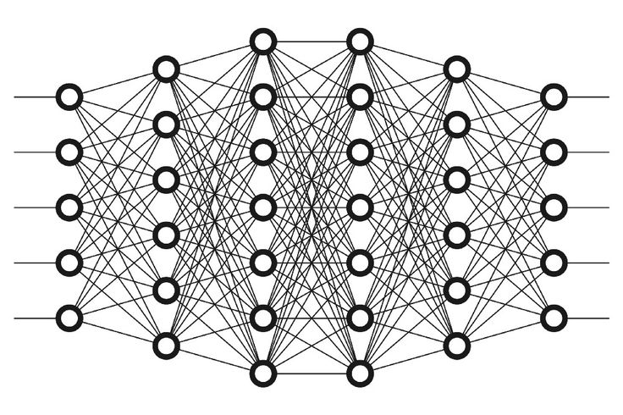
Why CNN ?
CNNs do not require human supervision for the task of identifying important features.
They are very accurate at image recognition and classification.
Convolutional neural networks also minimize computation in comparison with a regular neural network

Slide 19
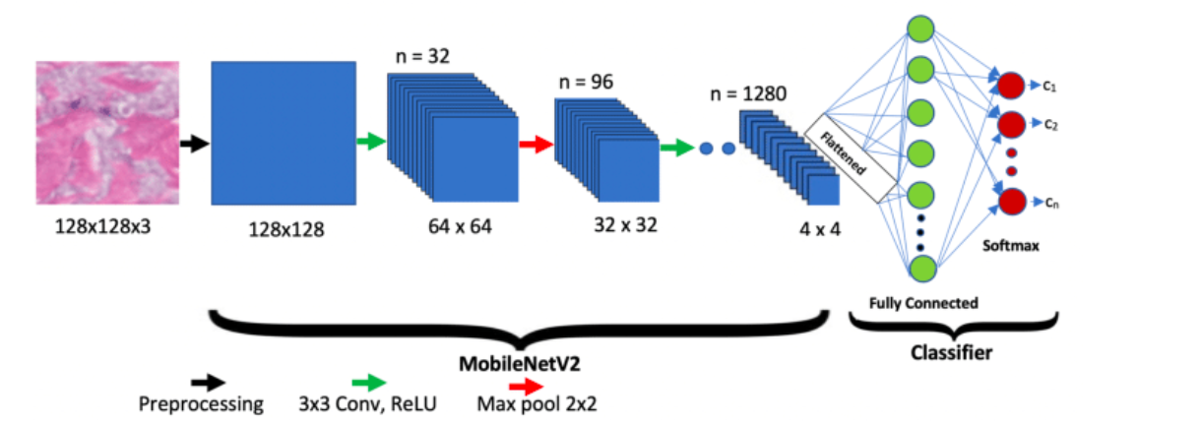
MobileNetV2
MobileNetV2 is a neural network architecture designed for mobile and embedded vision applications. It is a variant of the MobileNet architecture, specifically optimized for efficiency and speed while maintaining high accuracy in tasks like image classification and object detection.

Slide 20
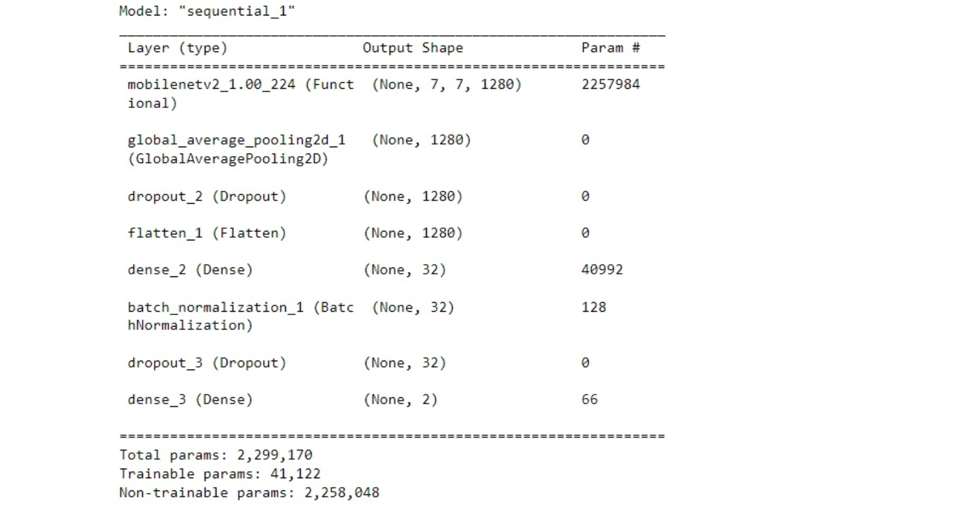
DL Model
Breast Cancer Detection model

Slide 21
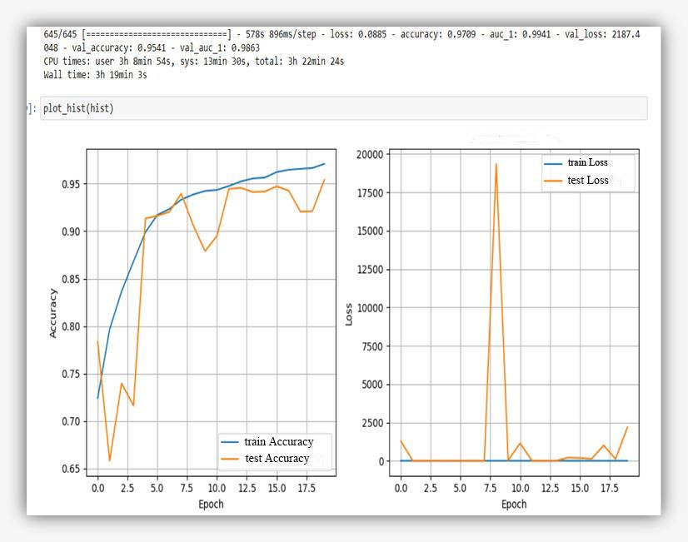
Accuracy
95%
95%
Train Accuracy
Test Accuracy

Slide 22
Survey

Slide 23
In the Breast Cancer detection we used MobileNetV2 model because:

Slide 24
Existing Solutions

Slide 25




Best Apps for Managing Your Breast Cancer
My Cancer Coach
Breast Advocate
Breast Cancer Recovery
Cancer Care Meditation

Slide 26
Future Work

Slide 27
We Hope
Improved Model Performance
Improving User Experience
Enhanced User Interaction
Big Data Analysis
“ A GOAL WITHOUT A Plan IS JUST A WISH ”

Slide 28
THANKS

